Slide 1


Project: Pac-Man
Team “Green Lantern”

Slide 2

The Team
Green Lantern
Kliment Todorov | Milko Venkov
Lachezar Nikolov | Pavel Hristov
Lubomir Angelov | Vencislav Konov

Slide 3
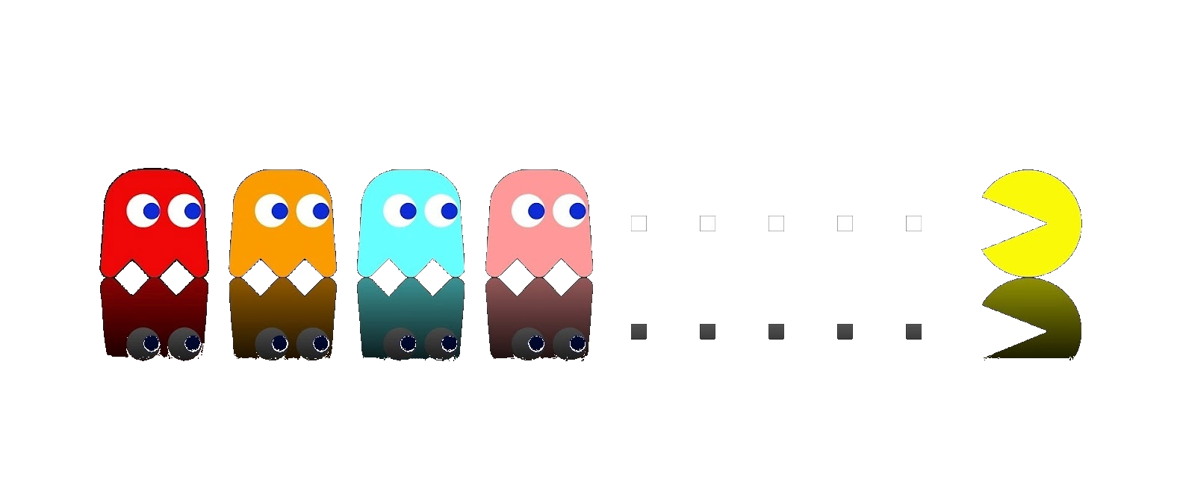
Pac-Man
Pac-Man was first released on May 20th 1980 in Japan and for a very short period of time the game became the favourite game of millions around the world.
Notes:
Short Intro into the presentation

Slide 4
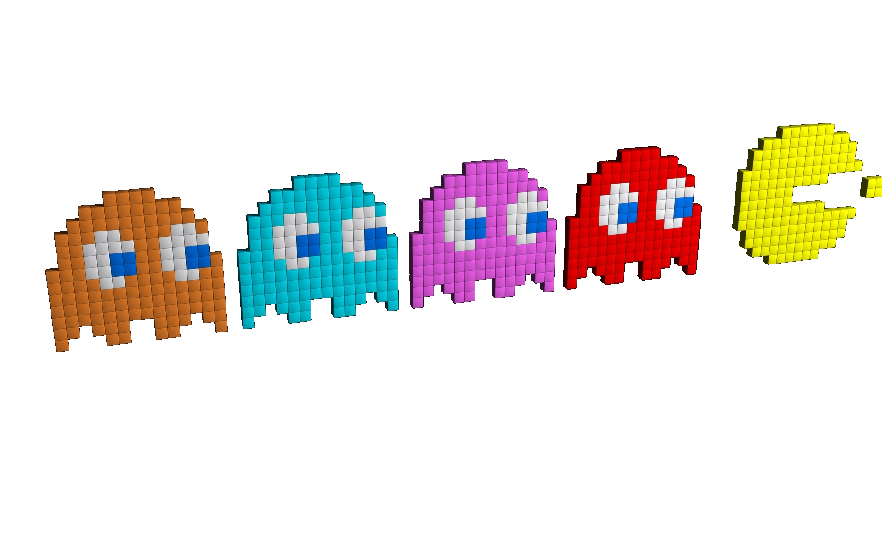
The characters
Notes:
We have used all characters from the original game and have implemented their exact behaviour based on the original game

Slide 5
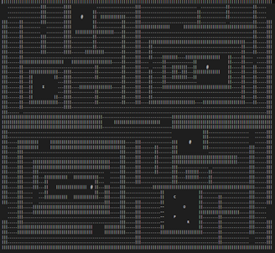
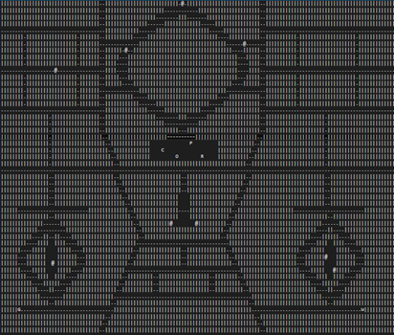
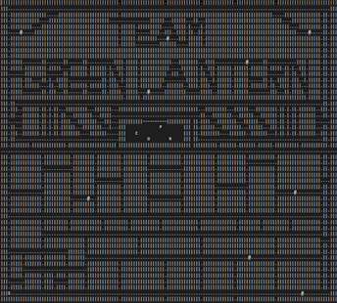
The Mazes

Slide 6
And Now…
The Game
Notes:
End of presentation – open Visual Studio and start the game for a demonstration.

